Slide 1

C# Fundamentals
Course Introduction
SoftUni Team
Technical Trainers
Software University
https://softuni.bg/

Slide 2
Table of Contents
Course Objectives
Training and Team
Course Organization
Course Infrastructure
Evaluation Criteria

Slide 3
Have a Question?
sli.do
#fund-csharp

Slide 4

Course Objectives

Slide 5
C# Fundamentals Objectives
Working with linear data structures
Arrays and Lists
Defining simple classes
Processing and manipulating strings
Regular expressions
Building а simple web project

Slide 6
Practical Programming Exam
Mid Exam
3 practical problems for 4 hours
Conditional Statements and Loops
Arrays
Lists
Final Exam
3 practical problems for 4 hours
Associative Arrays
Strings and Text Processing
Regular Expressions

Slide 7
Theoretical Exam
You will have 30 minutes once you enter
Multiple-choice with 1 or more correct answers
English
Automated quiz system
Available during the practical exam and 30 minutes after it
You can submit your answers just one time
Advice: Start it when you finish the practical exam

Slide 8

Course Organization

Slide 9
C# Fundamentals Module
13-Jan-2020
29-Feb-2020
4-Apr-2020
10-Apr-2020
C# Fundamentals
12 weeks * 3 times / week 18 credits
Start: 13-Jan-2020
Mid Exam: 29-Feb-2020
Theoretical Exam: 4-Apr-2020
Final exam: 4-Apr-2020
Re-Take Exams
Mid Exam Retake: 7-Apr-2020
Тheoretical Exam: 10-Apr-2020
Final Exam Retake : 10-Apr-2020

Slide 10

Homework Assignments & Exercises
Your homework is mainly work in class
Lesson days → slides + live demos + exercises
Exercise days → only exercises
How to submit your homework?
Submitted in the judge system
Do your homework when it's due
Assignments pile up quickly

Slide 11



Scoring System for the Course
Theoretical Exam 5%
Practical Exam (Final + Mid) 90%
Presence in class 5%
Evaluation
Homework 5 %

Slide 12

The Team

Slide 13
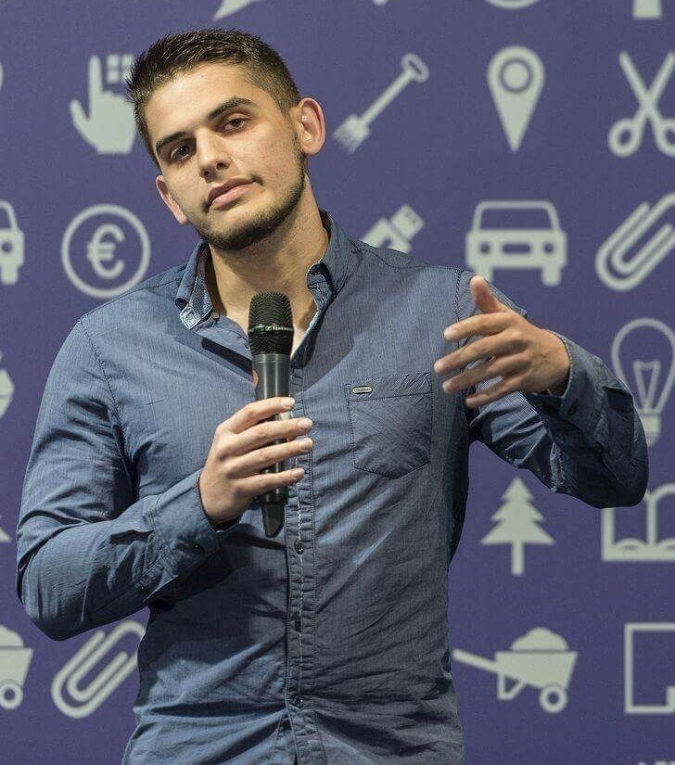
Viktor Dakov
Senior Developer SDE 3, Nuvolo
Worked at Amazon
John Atanasoff award
Participated in many programming contests
6+ Years of Experience as a Developer

Slide 14
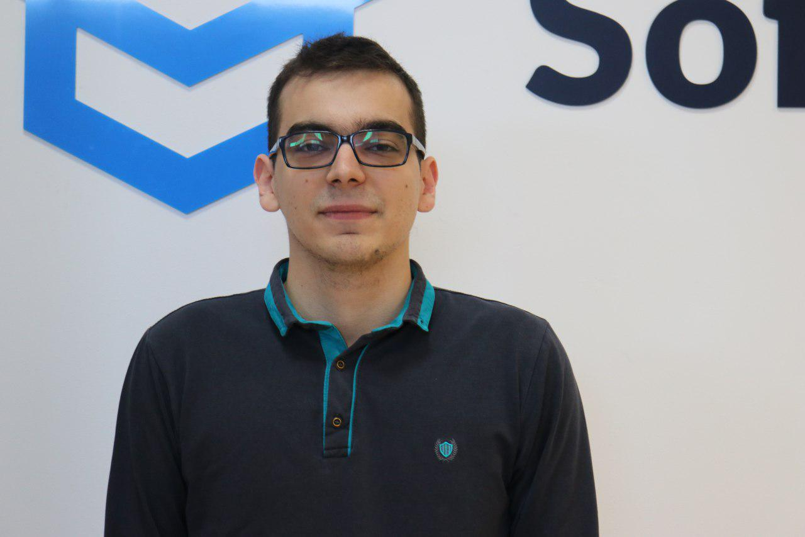
Kiril Kirilov
Program Lead @ SoftUni
Worked as a Front-End Developer
Passionate about .NET, JavaScript, Angular
Currently studying Math & Informatics at Sofia University (FMI)
Contacts:
k.kirilov@softuni.bg

Slide 15


Course Web Site, Forum and FB Group
Official web site:
Official discussion forum:
C# Fundamentals Facebook group:
softuni.bg/trainings/2438/csharp-fundamentals
softuni.bg/forum/categories/44
facebook.com/groups/FundamentalsModuleJanuary2020/

Slide 16
https://softuni.bg/courses/technology-fundamentals

Slide 17












SoftUni Diamond Partners

Slide 18




SoftUni Organizational Partners

Slide 19




Trainings @ Software University (SoftUni)
Software University – High-Quality Education and Employment Opportunities
softuni.bg
Software University Foundation
http://softuni.foundation/
Software University @ Facebook
facebook.com/SoftwareUniversity
Software University Forums
forum.softuni.bg

Slide 20

License
This course (slides, examples, demos, videos, homework, etc.) is licensed under the "Creative Commons Attribution-NonCommercial-ShareAlike 4.0 International" license

